Slide 1
Global Day of Code Retreat
#gdcr18 | #atx
@coderetreat | @excellaco
http://xluh.co/gdcr18

Slide 2
Welcome!

Slide 3
Logistics
Parking
Bathrooms
Charging Stations
Wi-Fi
Kitchen / Food & Beverage
Coat Racks & Bags
Emergency Exists

Slide 4
Thanks to our sponsors!

Slide 5
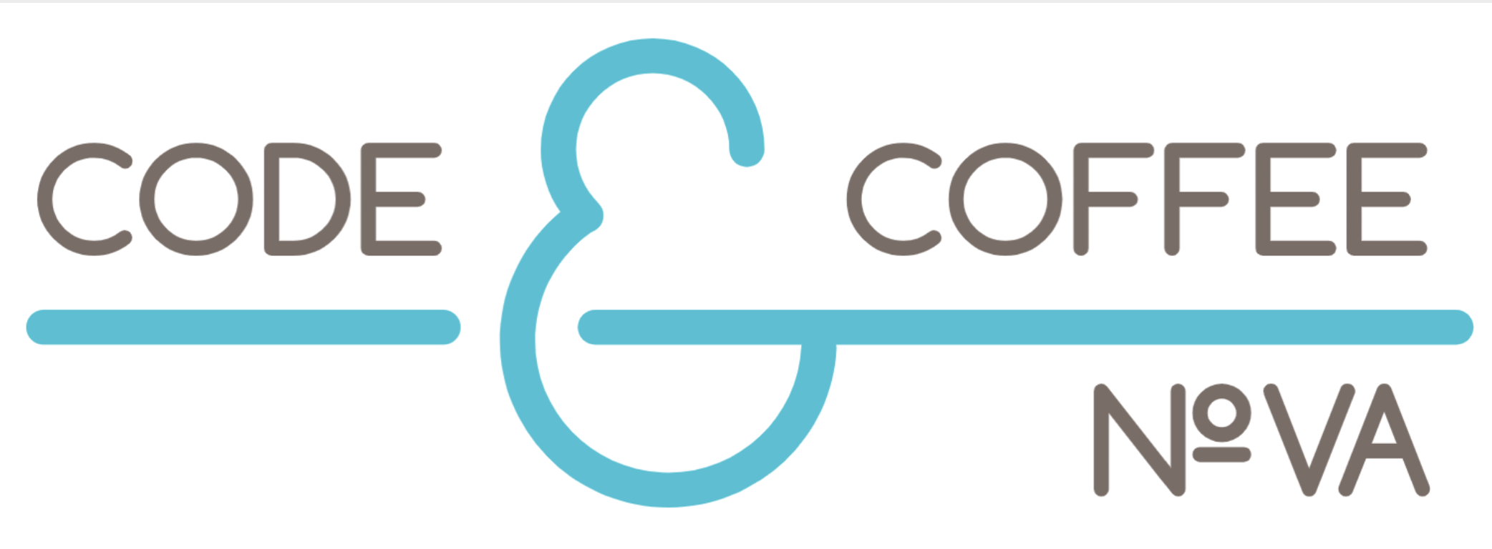
Thanks to our sponsors!

Slide 6
Today’s Retreat: The Schedule
9:00-9:15am | Arrival, Coffee / Breakfast
9:15am | Standup
9:30am | Writing Quality Code: A (brief!) Introduction
10:00am | Session 1
10:45am | Retro & Break
11:00am | Session 2
11:45am | Retro & Break
12:00pm | Lunch, Socializing
1:30pm | Session 3
2:15pm | Retro, break
3:00pm | Session 3
3:45pm | Retro, break
4:00pm | Session 4
4:45pm | Retro & Closing

Slide 7
Writing Quality Code
A (brief!) Introduction

Slide 8
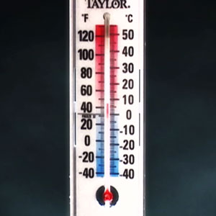
Brr, it’s cold in here!
How cold is it outside?
Let’s build a temperature converter to tell.
What can we start testing?
This Photo by Unknown Author is licensed under CC BY-SA

Slide 9
What is TDD?
Test-Driven Development is the idea of writing tests for your code as if the code already exists in the ideal state – even if that code doesn’t exist yet!
This way, we can be certain that the production code we write will work as we expect, because we are testing the production code even before we’ve finished writing it.

Slide 10
TDD: Red, Green, Refactor
Think
Refactor
Red
Green

Slide 11
TDD: Principles
First Law – You may not write any production code until you have written a failing test
Second Law – You may not write more of a unit test than is sufficient to fail, and not compiling is failing
Third Law – You may not write more production code than is sufficient to pass the currently failing test

Slide 12
TDD: Psychology
TDD breaks complex problems into manageable units
TDD provides a positive feedback loop
TDD makes changing existing software easier
TDD encourages taking small steps
As a result:
TDD saves time, money, and frustration!

Slide 13
Introducing Conway’s Game of Life
#LetsDoThis

Slide 14
Rules: Conway’s Game of Life
Given a 2D Universe
Given an initial generation (“seed’)
The below rules are applied simultaneously on tick:
A live cell with < 2 live neighbors dies
A live cell with 2-3 live neighbors lives
A live cell with > 3 live neighbors dies
A dead cell with 3 live neighbors becomes alive

Slide 15
Global Day of Code Retreat 2018

